Slide 1
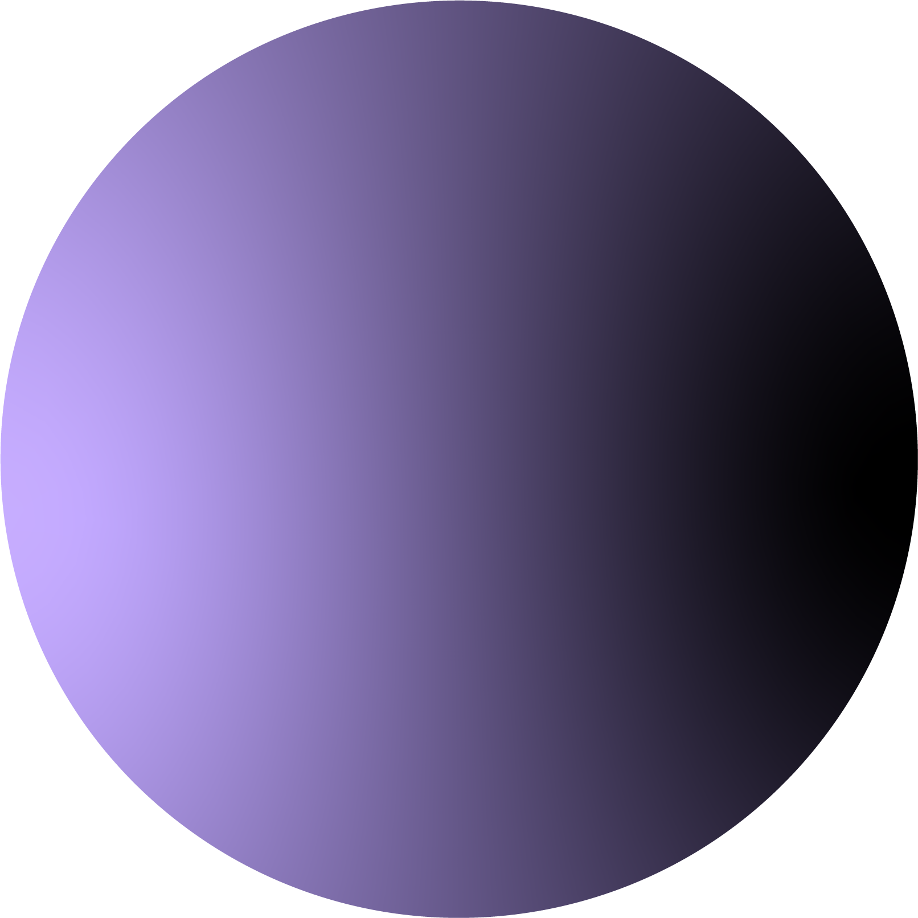

POTTR.APP
CSC-648-04 Team -01
He (Damon) Chen (Team Lead)
Kelvin Chan (Frontend)
Steven Liao (Backend)
Chaoyi Ying (Frontend)
Alex Chau (GitHub)
Hugh Nguyen (Scrum Master)
Notes:
Damon

Slide 2
About our product
Pottr is a novel video monetization platform that offers low-risk video game clip based competitions.
Notes:
Hugh
Pottr is made up of many time-limited tournaments where users can submit a video game clip along with an entrance fee, which contributes to a “Competitor” prize pool.
Other Non-competitor users on Pottr are eligible to vote for submission(s), which then the top submissions with the largest number of votes receive some proportion of the “Competitor” pool,

Slide 3
Our Customers
We target the gamers, people who enjoy playing video games and want to post their cool video game clips
Gamers from content creators to the average college student who like to play in their free time
An example of our customer would be your average gamer Joe, who just likes to play games on his free time
Notes:
Hugh
PERSONA:
Joe, a college student
In his Free time, Joe likes to play competitive video games. Although he might not be that good, occasionally he gets moments where he pulls off an amazing play in the game.
He is able record the moment and wants to share it for other people to view and perhaps earn a bit of money off of it from the views.
Joe does wants a dedicated platform meant for video game clips where it won’t be drowned out from a plethora of other contents.

Slide 4
Other Competitors
YouTube - already a well known platform
Twitch - popular places for streamers
Our advantages
Ad free
Easy to find clips under certain categories
Notes:
Hugh
YouTube
Free to post youtube videos
Good explore algorithm
Paid entry to competition can prevent low quality video spam
You can vote with your wallet
Twitch
Is connected with your amazon account and can support creators as a feature if you already have amazon prime
Already have twitch clips where you can pull highlights off of streams
Easier access to find clips
Only game specific content on our site
Don’t need to spend hours a day streaming to earn revenue just post highlight clips will be enough
TikTok
Edit templates and tools to make clips more pleasing
Streaming, allow donations if big fan base
can post any type of content as long as it is pleasing.
Competitions for increased user engagement
Content is necessarily game-related higher quality
lower barrier of entry to earn revenue

Slide 5
Software Stack
We Used Amazon Web Service as our server host
Javascript for our backend language
MySQL for our database
Nginx for our web server
Notes:
Hugh

Slide 6
Team building
Team Meetings
We would have two official weekly meeting with all the group members on Monday and Saturday to debrief on what we’ve been doing that week, and assign new weekly tasks
Notes:
Hugh hands it over to Kelvin to do demo
We also use discord as a community group to post questions and resources to help one another. There each team member can track what has been done and what has yet to be completed to see how much left to complete each milestone.
Now I would like to hand it to Kelvin to demonstrate the Demo of our app

Slide 7
Development
Frontend Team: Kelvin and Chaoyi
Backend Team: Steven and Alex
Database: Damon
Notes:
Kelvin

Slide 8
Frontend Design
Kelvin C
Chaoyi Ying
Notes:
Chaoyi

Slide 9
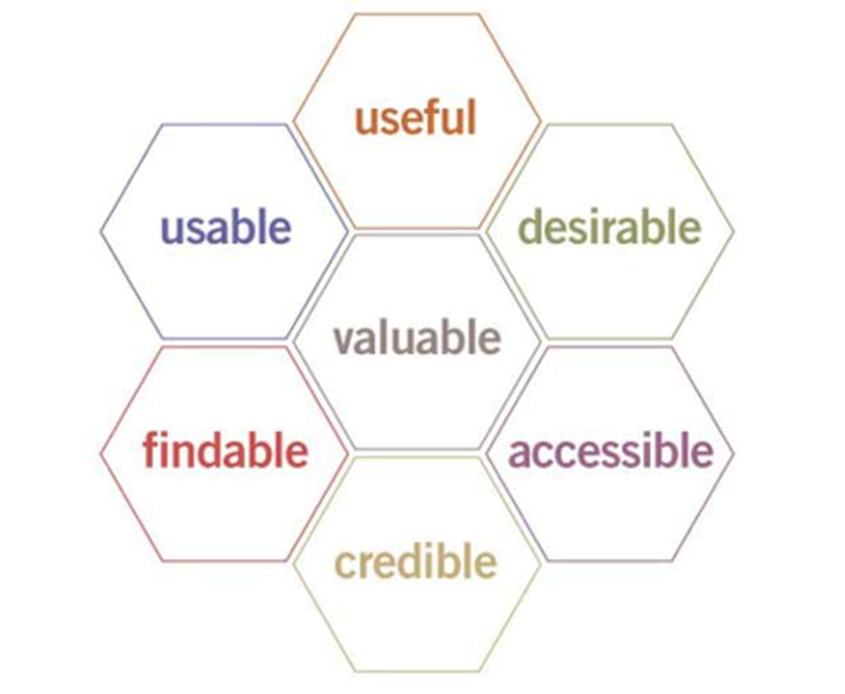
UX principles
Notes:
Chaoyi

Slide 10
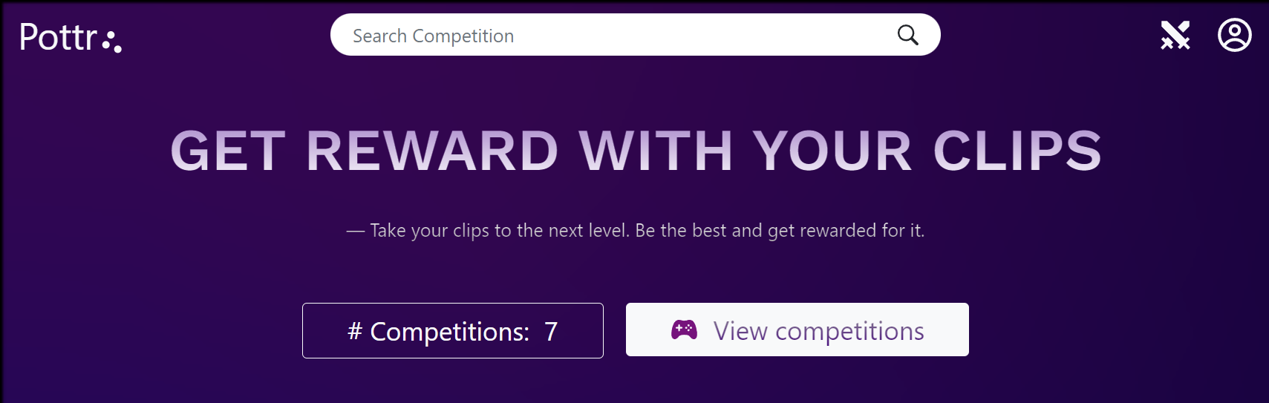
Findable
All main functions of our web app are easy to find and achieve via Nav bar
Notes:
Chaoyi

Slide 11
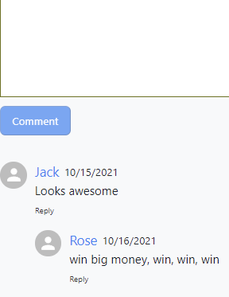
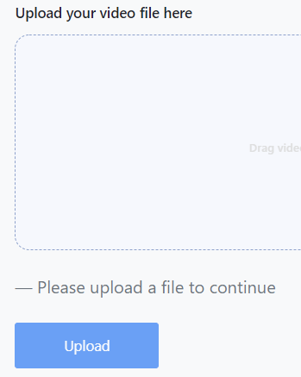

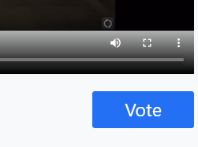
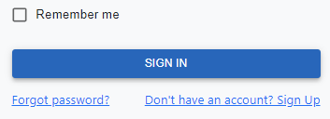
All function is simple and straightforward, you were already familiar with
Users do not need to read instructions on how to find the specific functions
Notes:
Chaoyi

Slide 12




Icon
For sign in
For searching
For log out
For compete
User do not need to recognize what the icon stands for, very straightforward.
Notes:
Chaoyi

Slide 13
Credible - Increase trustability by using our app
Security
Clean & Ads free
Earn money or get actual benefit (we are not spam website)
Notes:
Chaoyi

Slide 14
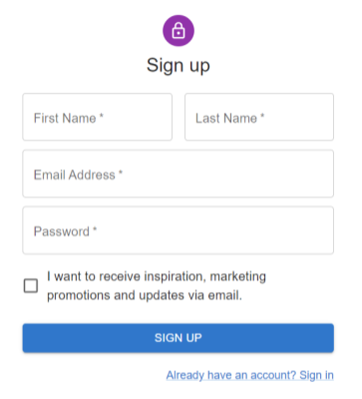
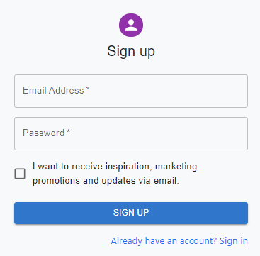
Effort for Credibility improvement
User care about their personal information
No name, phone number, location info and etc., required
An email address is good enough for register
Won`t send users mail unless they agree
Notes:
Chaoyi

Slide 15
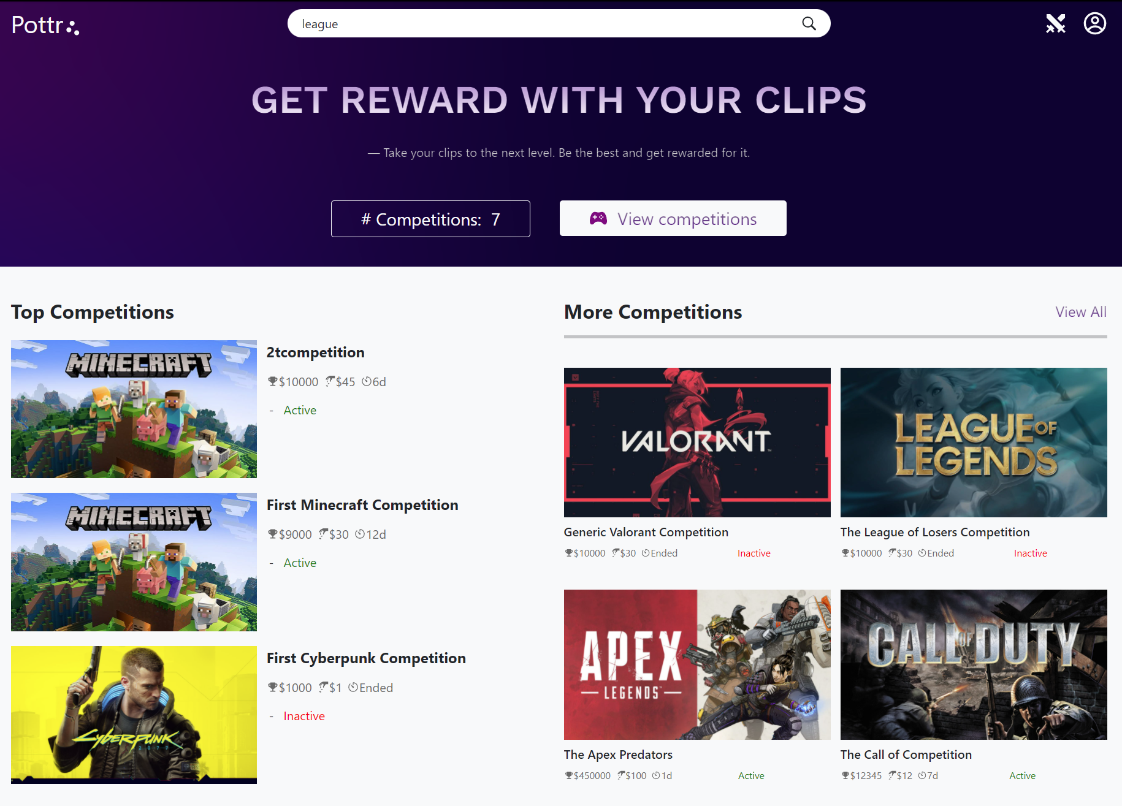
Clean & Ads free
User feel safe and trust our app
Notes:
Chaoyi

Slide 16
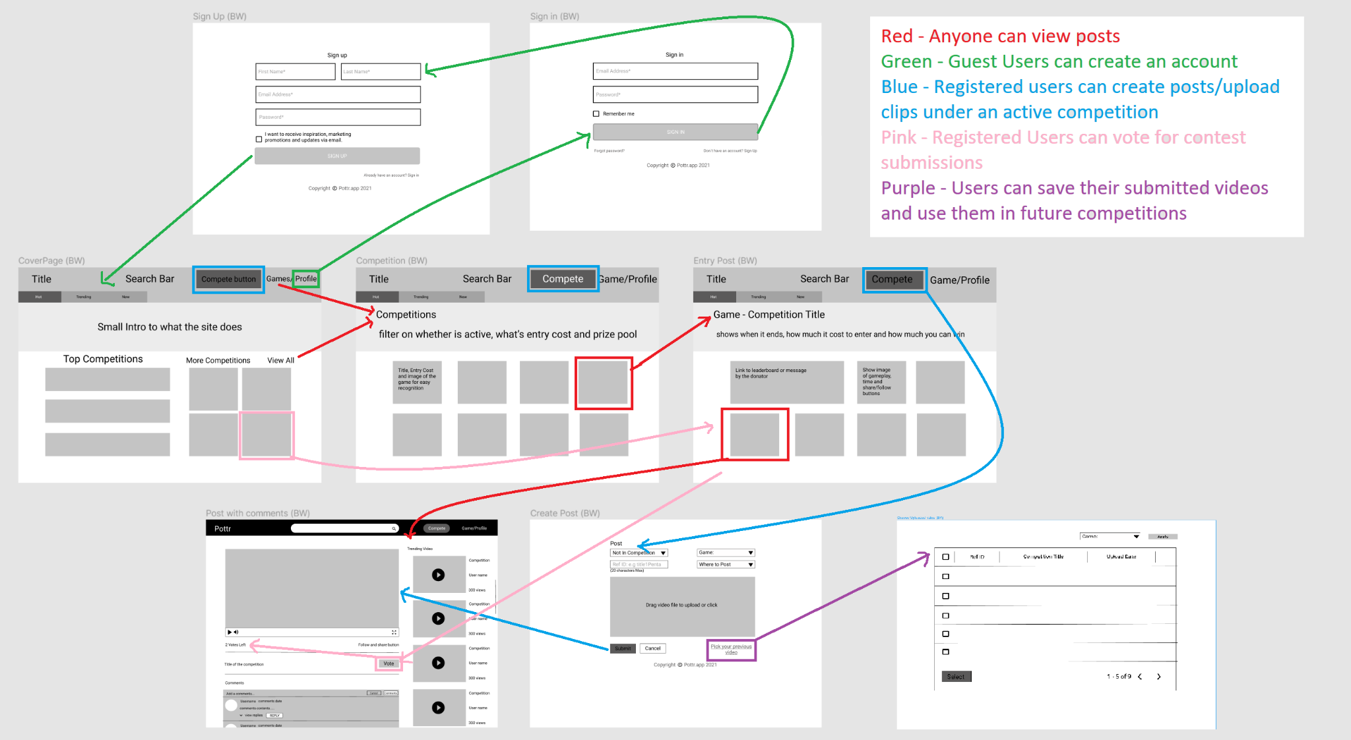
Useful
Notes:
Chaoyi

Slide 17
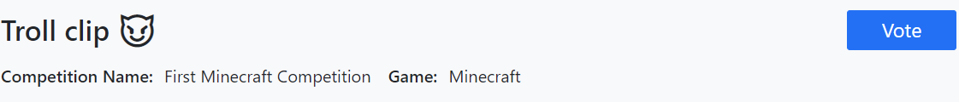
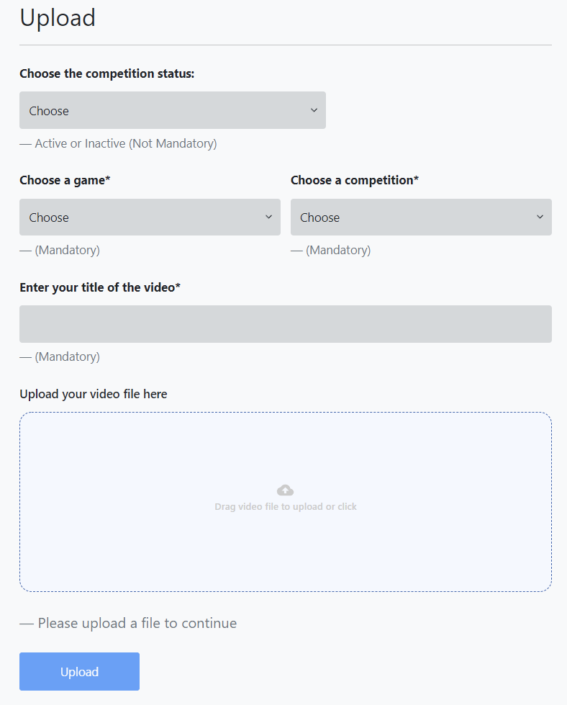
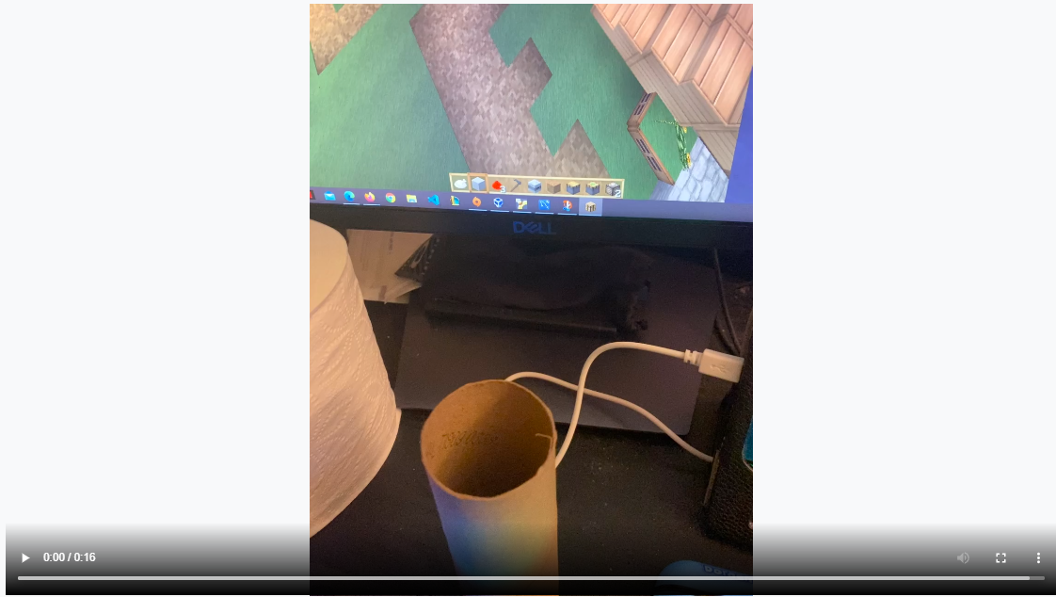
Vote for competition!
Watch clip for entertaining
Upload own video for exposing
and earning money
effectively and efficiently achieve
user end goal with our app
Notes:
Chaoyi

Slide 18
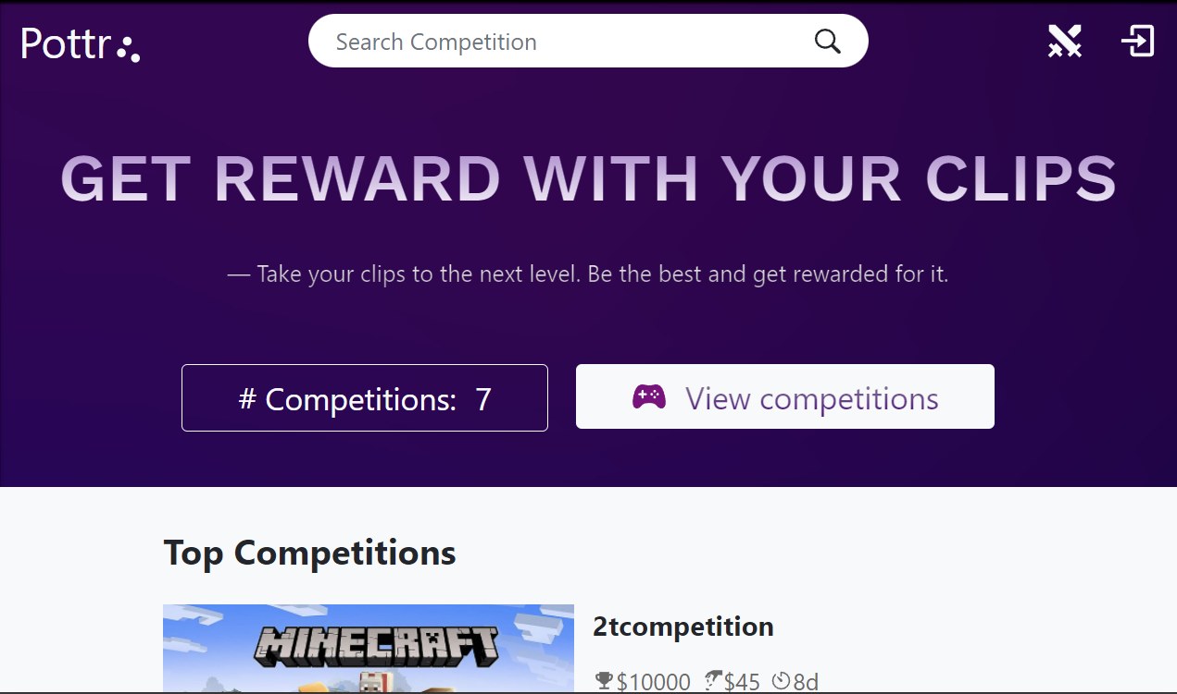
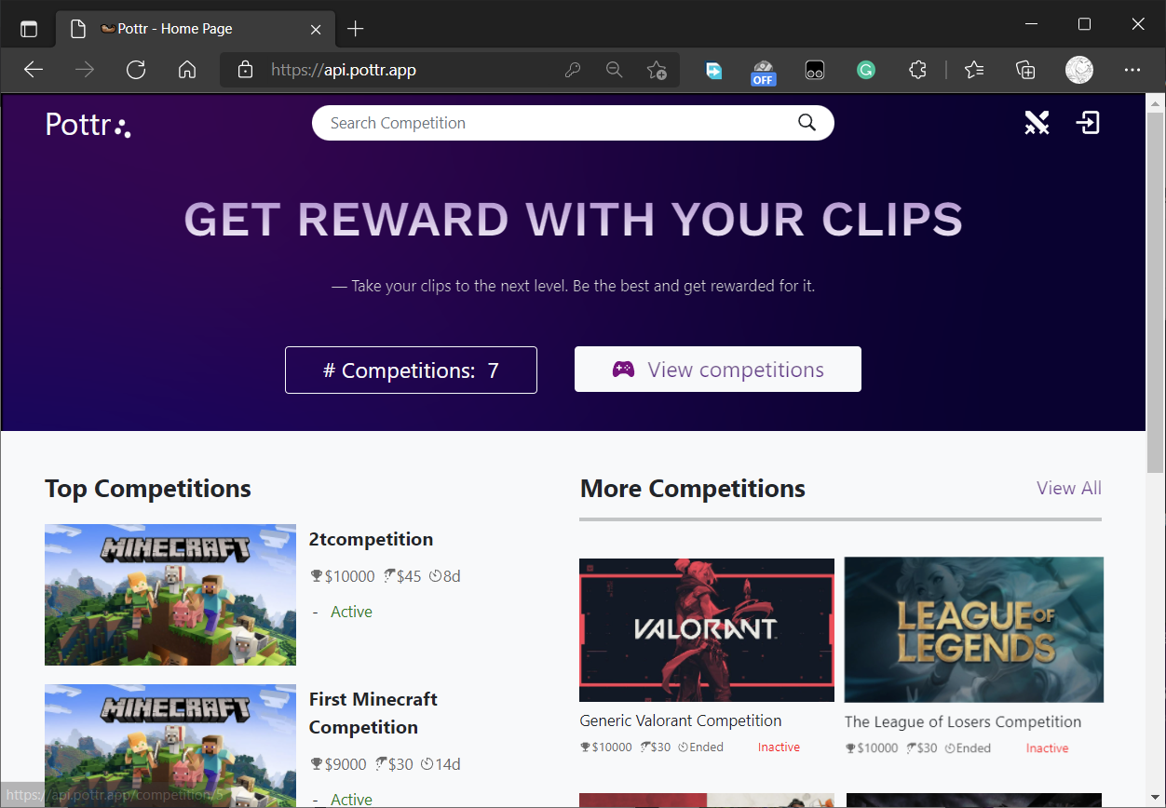
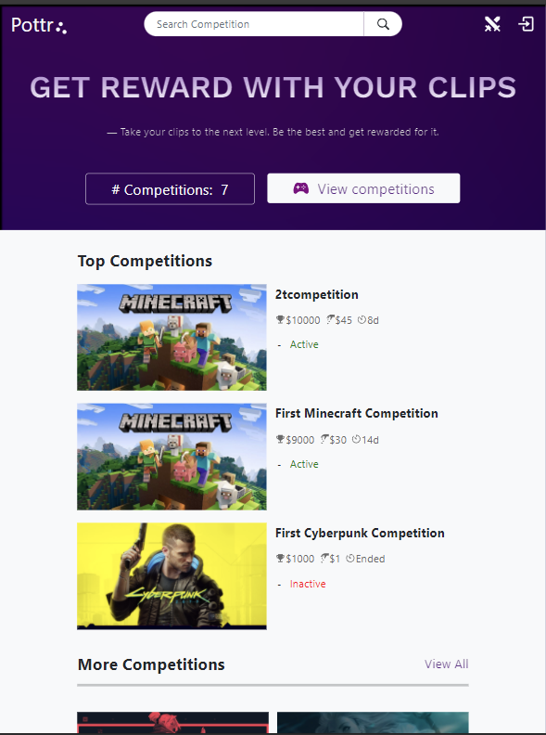
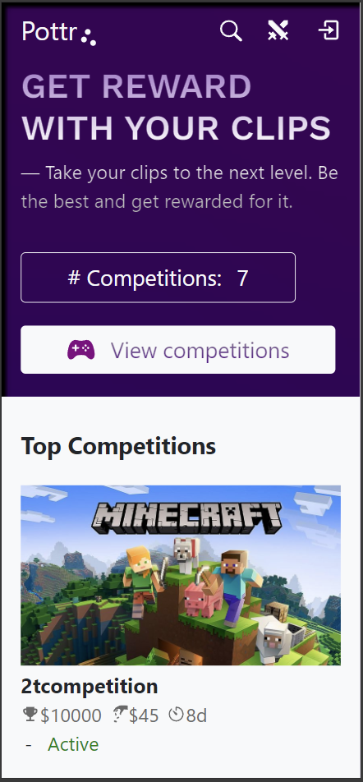
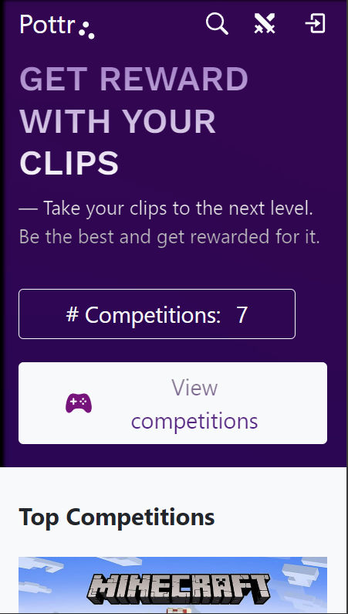
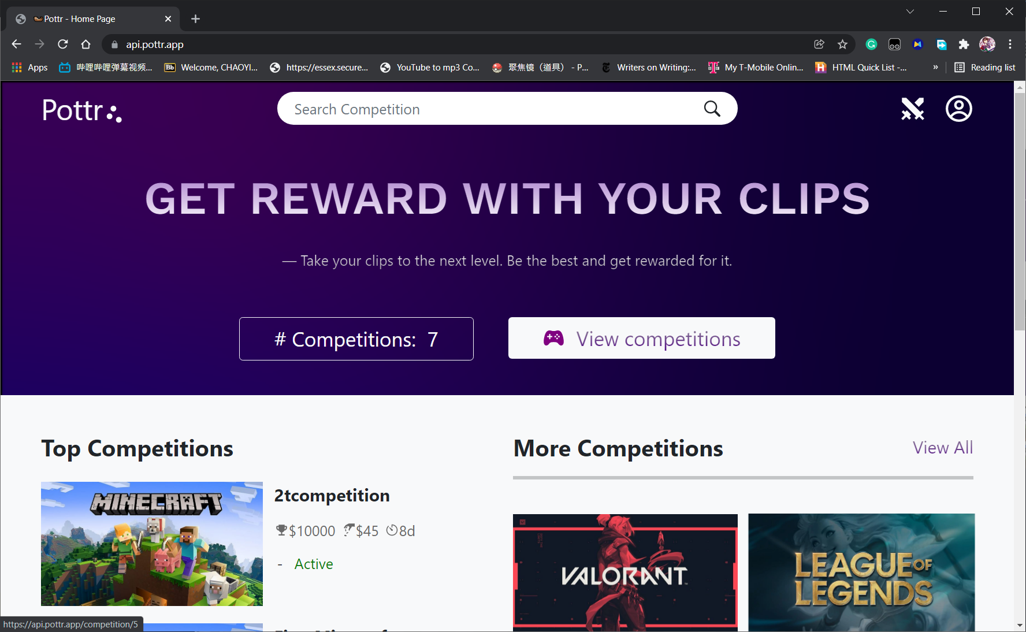
Usable
Nest Hub
Works well in various platform or browser
iPad
iPhone
Galaxy
Edge
Chrome
Notes:
Chaoyi

Slide 19
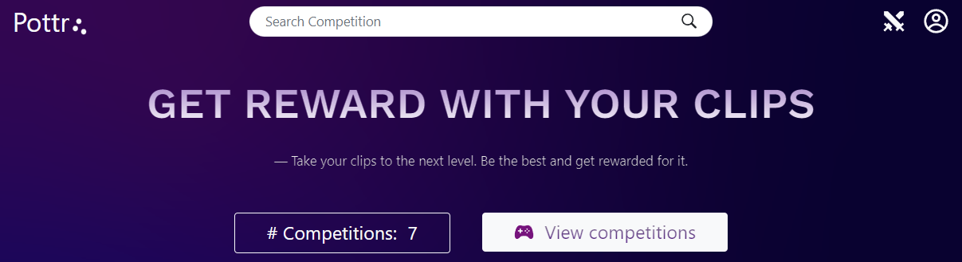

Scrolling
Easily get back to top to where all the main function locate
So user won't waste time on scrolling or find function button
Notes:
Chaoyi

Slide 20
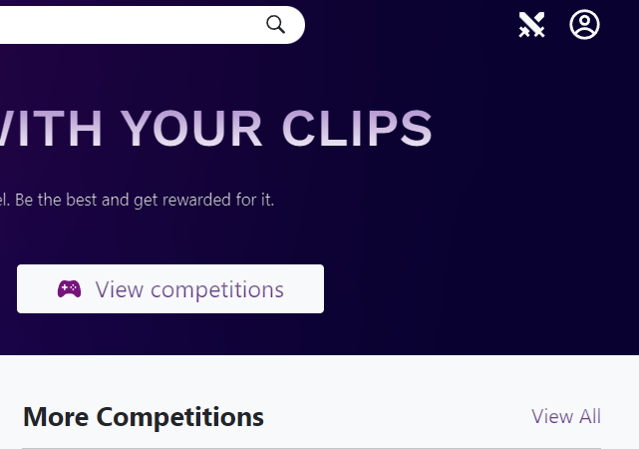
One hand operation
All main function button that
user will use are all locating at
the right half side of our app
Important for user experience!
Notes:
Chaoyi

Slide 21
Backend
Notes:
Steven
Hello, I am Steven and I will be talking about the backend.

Slide 22
Backend
Design
Development
Hardships
Notes:
Steven
I will be talking about how we designed the backend, how we developed it, and some of the hardships we went through when making it.

Slide 23
Model-View-Controller
Examples of it in our project
Models to run MySQL queries
Controller to interact with models and return data to the frontend
Views are handle by the frontend
Notes:
Steven
For our design, we used the Model-View-Controller pattern as the design of our backend. We would have models to handle the interactions with the database, routes as controllers to interact with the models and views, and the frontend to handle the views.

Slide 24
Model-View-Controller
Benefits of using it
Work on models and routers parallelly
Debugging code was easier since we were able to find which file had the bug
We can change a small part if we needed to instead of a whole file
Ex. We needed to update an MySQL query so it had a bit more information for the requester to use.
Notes:
Steven
Some of the benefits of using a model-view-controller was that we were able to work on the models and routers at the same time. It also made it easier to debug the code. Finally, it made it easy to make small changes such as when Kelvin wanted the data for competitions to come with the data for categories.

Slide 25
Development
Creating MySQL Models
Test MySQL queries in MySQL workbench
Creating routes
Testing routes with Insomnia
Implemented models and routes in order of what items required which according to the database
Ex. User -> Competitions -> Posts -> Comments
Notes:
Steven
We developed the models by testing mysql queries in mysql workbench. For the routes we would test them using insomnia so make sure the routes were returning the data that we wanted. We implemented our models and routes in the order of what entities required which entities

Slide 26
Hardships
Getting code finished so frontend can utilize the backend
Deployment of code / Working with Nginx
CORS
Sessions
Notes:
Some of the hardships we had were getting code finished in time so our frontend devs could utilize the backend. Another one was deploying the code because we had trouble with nginx, cors and sessions because the frontend and backend were on different domains.
Steven introduces Damon

Slide 27
Database
MySQL server was used
Used AWS RDS
We accessed it using MySQL workbench to easily add tables and edit the database design
Used MySQL workbench modeling tool to create an ER diagram of our database
Notes:
Damon

Slide 28
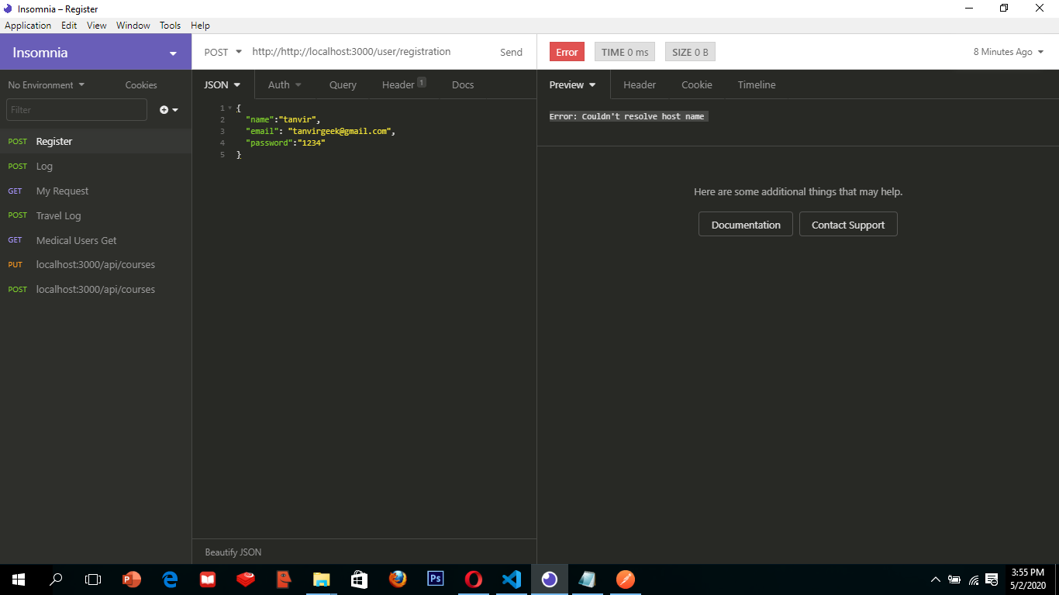
Testing
Insomnia for testing
We are able to write unit tests and test Our route functions, and makes sure POST Requests and GET requests are working
Notes:
Damon introduces Alex for GitHub

Slide 29
Code Review
Code review was performed when merging from working branches into production branch.
Team members attempting to merge code would open a Pull Request, then request 1-2 reviewers to review their code changes and/or additions.
Discussion, comments, and revisions would happen as necessary before reviewers approved the changes.
Once approval from all reviewers had been given, the PR would be merged.
Notes:
Alex

Slide 30
GitHub
Notes:
Alex

Slide 31
GitHub
Used for:
Single source of truth
Project Management
Notes:
Alex

Slide 32
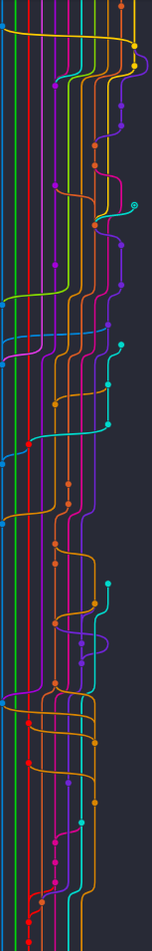
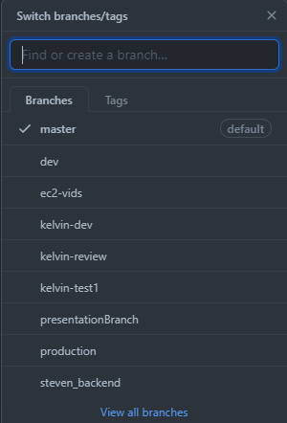
GitHub: Single Source of Truth
Notes:
Alex
Source of truth is not actually singular, but needed consolidation to create a single source. Much of my job as github manager was working with the frontend and backend leads properly work with and merge branches.

Slide 33
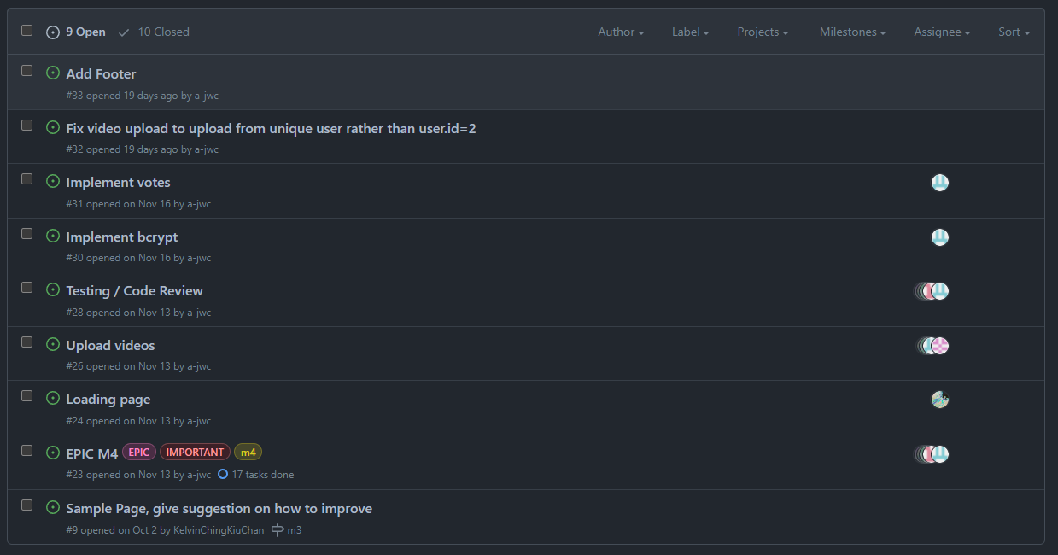
GitHub: Project Management
Notes:
Alex
Tried to use Jira, defaulted back to GitHub

Slide 34
Hardships
Scheduling time to merge
Local <-> EC2
Notes:
Alex

Slide 35
Future Plans
Notes:
Alex

Slide 36
Current State
Video hosting website
Notes:
Alex

Slide 37
Idea
Video hosting website
+
Finance
Notes:
Alex

Slide 38
Possible Future Roadmap
Milestone 1 (Fixing / Planning):
Fix URL 😬
Clean up and organize codebase
Javascript -> Typescript
Further develop product
Milestone 2 (Migrating):
Experiment with decentralized storage
Experiment with smart contracts / parallel chains
Experiment with deployment to test networks
Research and integrate with lending protocols
Notes:
Alex

Slide 39
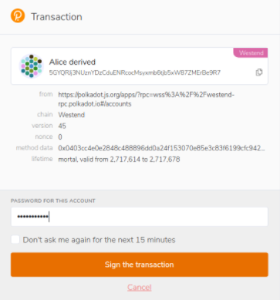
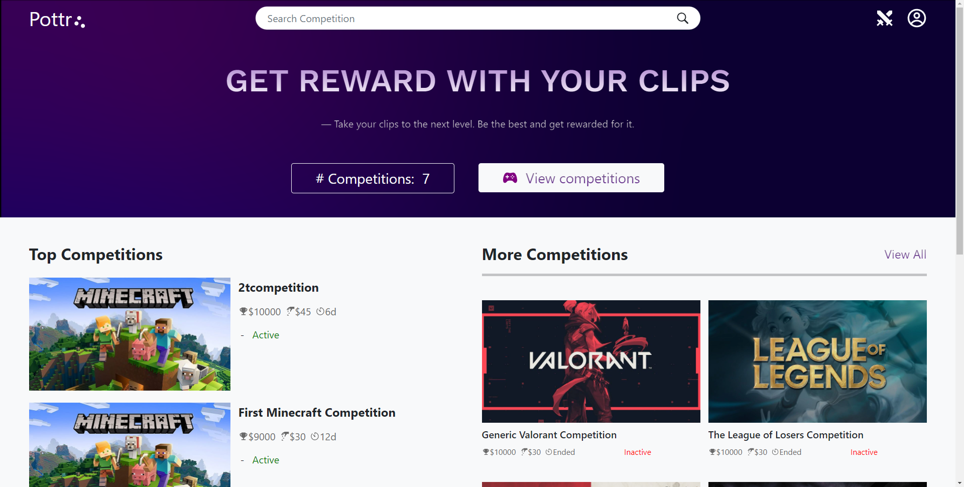






Data Flow
Frontend / video storage
User Auth
Authentication
Backend
Lending protocol
L0 Consensus Layer
Prize
Money
L1 Smart Contract Layer
Cross Chain Interoperability
Notes:
Alex
Another potential data flow: replace authentication with normal authentication, used deposited funds would be converted and used for prize money generation

Slide 40
Challenges
Technical
Unstable technologies
Poor UX
Exploitable mechanics
Unexpected requirements
Business Model
Team
Scheduling
Different priorities
Legal
AML / KYC
Notes:
Alex

Slide 41
Q&A
Notes:
Alex

